Slide 1
NAHUM

Slide 2
Historical information (International standard bible encyclopedia)
790-750 BC - Jonah Preaches to Nineveh and they repent
663-607 BC - Nahum the Elkoshite prophesied about the destruction of Nineveh
607-606 BC - Nineveh is sacked by former subjects including the Medes, Persians, Babylonians, Chaldeans, and Cimmerians

Slide 3
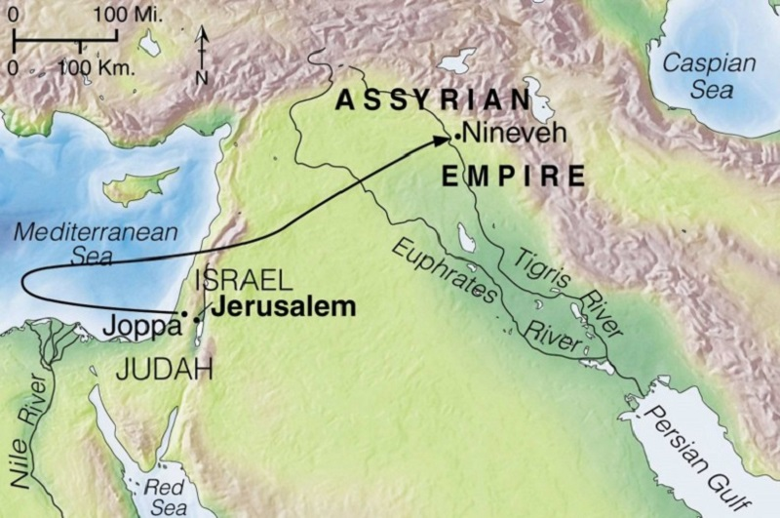

Slide 4
Nahum
God’s Relationship with his Enemies
Destruction of Nineveh
Woe of Nineveh
Nineveh verses America

Slide 5
Nahum
God’s Relationship with his Enemies
Nahum1:2-3, 6, 15, Hebrews 10:26-31
Destruction of Nineveh
Woe of Nineveh
Nineveh verses America

Slide 6
Nahum
God’s Relationship with his Enemies
Destruction of Nineveh
Nahum 2:1, 5-6, 13, 2 Peter 3:10-12
Woe of Nineveh
Nineveh verses America

Slide 7
Nahum
God’s Relationship with his Enemies
Destruction of Nineveh
Woe of Nineveh
Nahum 3:5-6, 18-19, Luke 13:22-30
Nineveh verses America

Slide 8
Nahum
God’s Relationship with his Enemies
Destruction of Nineveh
Woe of Nineveh
Nineveh verses America
Romans 12:1-2, 2 Peter 3:13

Slide 9
applications from Nahum
Continue To Preach The Word!

Slide 10
Applications from Nahum
Continue To Preach The Word!
Trust God’s Omnipotence!

Slide 11
Applications from Nahum
Continue To Preach The Word!
Trust God’s Omnipotence!
Do Not Hesitate to Serve God!

Slide 12
Applications from Nahum
Continue To Preach The Word!
Trust God’s Omnipotence!
Do Not Hesitate to Serve God!
Focus On Heaven!

